Slide 1
Completing DECA Form 40-15 and 40-16
Introduction
This Instructional tool will assist DECA Vendors on how to complete and certify the DECAF 40-15/40-16 using the Data Entry Sheet. (Ensure you are using the version dated April 21, 2025)
This Session will guide vendors, step by step on how to complete the Data Entry Sheet that will reflect on the
40-15 and 40-16.
This tutorial was developed to provide industry partners a standard way of how the form needs to be completed, and guidelines regarding the details that are required.
**Failure to comply with the guidelines will result in a REJECTED FORM**

Slide 2
DECAF 40-15/40-16 Terminology
Regional Stock List (RSL Codes):
  K = Mandatory item carried in all stores in all DeCA Conus areas.
  M = Mandatory in more than one regional area but not all regions
  R = Mandatory item carried in a specific region/area.
  S = Optional store specific item carried in a specific area.
  O = Optional One-Time Buy available for a limited period of time.
  H = Long term hold due to supply chain shortage.
  T = Test item.
  P = Item being phased out pending delete.
  Numbers 1 thru 5 (following the alpha product stock code) indicate store size required to stock the product
  Intent: Vendor selects from drop-down New Item, File Maintenance, or Promo Presentation to indicate intention of items entered into the data entry sheet.
Sales Representative: Person in charge of confirming that all information on the 40-15 is accurate before it is sent to DeCA.
SH/PLT: Identifies if the item is a shipper or pallet.
UOM: Measurement of item that is being packaged i.e., pounds - LB, count -CT, box -BX
UI: Unit of Issue is a 2 letter designation that signifies count, measurement, container of item.
UPK: Unit Pack Size is the pre-defined packaging size.
Vendor Number: Defines the number established by DeCA contracting. These vendor numbers typically will end in -01 for Conus regions and/or -02 for OCONUS regions. (Example: N003-01, N003-02) If you have the same items for the same vendor number ensure you indicate -01, -02, etc. in the vendor number box. This helps File Maintenance identify which contract belongs to CONUS/OCONUS (A232-01, A232-02)

Slide 3
DECAF 40-15 Terminology
Brand Name: commercial item for resale within a commissary must also be a commercial item that is regularly sold outside of commissary stores under the same brand name as the name by which the commercial item will be sold in, at, or by commissary stores.
Broker: An official representative authorized by the manufacturer to act on the manufacturer's behalf to fulfill contractual requirements.
Contract Number: defines what year a contract was established, Procurement Instrument Identification Number (PIIN)
Distributor Availability: Date is the date the item will be available to distributors so stores can start placing their orders.
Global Location Number (GLN): refers to the globally unique GS1 System identification number for legal entities, functional entities, and physical locations. A GLN is comprised of 13 digits that together represent a GS1 Company Prefix, Location Reference, and ‘check digit’. Supply side trading partner locations generally include corporate headquarters, regional offices, warehouses, plants, and distribution centers.
GTIN: acronym for “Global Trade Item Number” and refers to the globally unique GS1 System identification number for products and services.
Manufacturer: person or company that makes goods for sale (I.e., Hershey)
Nomenclature: identifies the item description
Presented/Accepted For: Check all areas the items will be available for.

Slide 4
Components of the DECA 40-15
DECAF 40-15 will come to the vendor in Excel Format. All information entered into the DATA ENTRY SHEET will populate on both the 40-15 & 4016. Ensure all information is accurate before presentation to DeCA.
***All forms MUST CONTAIN images of the items being presented***
  Data Entry Sheet/EBS Tab (This is where vendors will fill out their company’s information.)
  40-15 Special Factor (This sheet also for a special factor Per LB delivery fee applied for meat items.)
  40-15 Mandatory (This will be the initial page that generates the first 4 items the vendor entered into the Worksheet – 10 continuation presentation sheets available; This tab includes a section at the bottom that is for any additional Vendor remarks to include pictures of the products. )
  40-15 for CRV only ( This will be used strictly for items that have CRV-California Redemption Value)
  40-15 Scale Label Info ( This page for PLU/Weight items – Enter Weight on this tab)
  40-15 Scale Label Nutrition Facts ( This page for PLU/Weight items – Enter Nutrition)
  40-15 cert - New Items (Where the items will populate from the data sheet in a list from and where the vendor will verify the items and digitally sign once excel is converted to PDF.
NOTE: The 7 tabs listed above will be followed by approximately 10 CONTINUATION pages titled 40-15 PRES CONT. where the additional items will display.

Slide 5
Components of the DECAF 40-15 continued
  CONTINUATION PAGES are 4 OPTIONAL TABS:
  4015 REMARKS Tab (This page does NOT translate to any other form, this will be for the VENDOR’s information ONLY, the images or info entered here will not populate on 40-15.)
  40-15 EAST DODAAC tabs (Would be used if a vendor had multiple contracts at various DECA locations/regions)
  40-15 WEST DODAAC tabs (Would be used if a vendor had multiple contracts at various DECA locations/regions)
  40-15 LOCAL PRICING/LOCAL PRICING CONT. (Used to enter UPCs that have a specific local cost)

Slide 6
Components of the DECAF 40-16 – Promotional Items
DECAF 40-16 will initially come to the vendor in Excel Format. All information entered into the DATA ENTRY SHEET will populate on both the 40-15 & 4016. Ensure all information is accurate before presentation to DeCA. The 40-16 forms are located directly after all of the 40-15 Optional Tabs.
  Data Entry Sheet/EBS Tab(1st tab of the entire workbook) When you filled this out it populates to both the 40-15 and 40-16.
  40-16 Mandatory (This will be the initial page that generates the first 4 items the vendor entered into the Worksheet – 10 continuation presentation sheets available; This tab includes a section at the bottom that is for any additional Vendor remarks to include pictures of the products. )
  40-16 LOCAL PRICING/LOCAL PRICING CONT. (is optional if there is local promotional pricing.)
  40-16 EAST /40-16 WEST DODAAC tabs are optional (Would be used if a vendor had multiple contracts at various DECA locations/regions)
  4016 REMARKS Tab (This page does NOT translate to any other form, this will be for the VENDOR’s information ONLY, the images or info entered here will not populate on 40-16)
  IMPORTANT: If the vendor has DIFFERENT PRICING based on a specific Location/Region different forms need to be sent for each AREA.

Slide 7
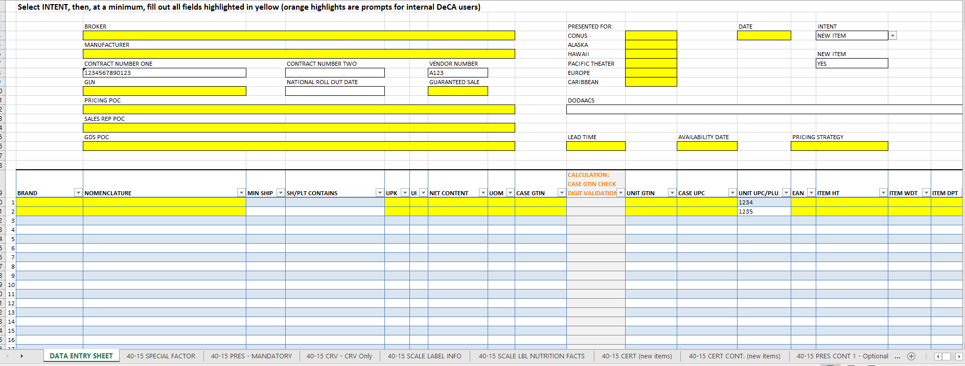
Filling out the NEW 40-15 for NEW ITEM Submission
Once the vendor selects the appropriate “INTENT” IN DROP-DOWN selections, the mandatory cells that will need to be completed by the vendor will highlight in YELLOW. This example is for NEW ITEM submission

Slide 8
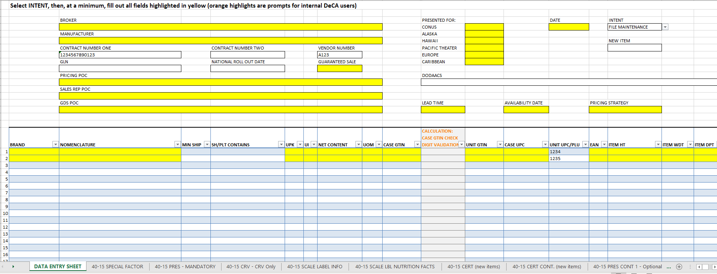
Filling out the NEW 40-15 for FILE MAINTENANCE Submission
Once the vendor selects the appropriate “INTENT” IN DROP-DOWN selections, the mandatory cells that will need to be completed by the vendor will highlight in YELLOW. New is the example for FILE MAINTENANCE submission

Slide 9
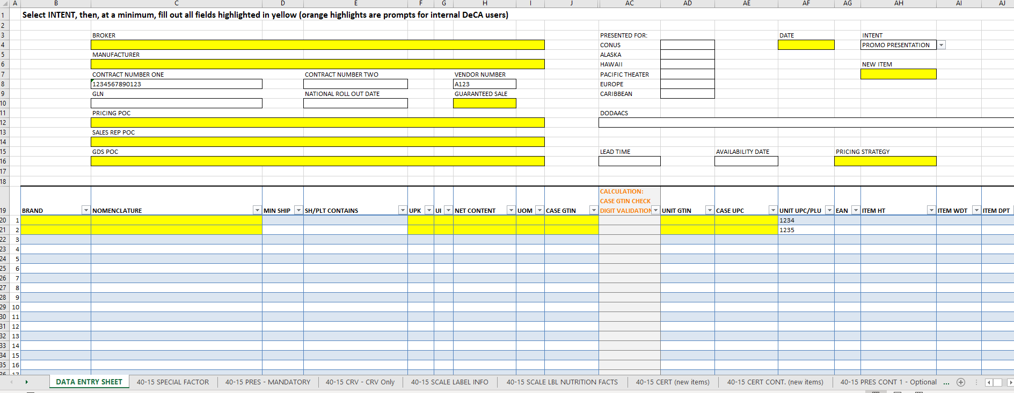
Filling out the NEW 2025 version 40-15 for PROMO PRESENTATION Submission
Once the vendor selects the appropriate “INTENT” IN DROP-DOWN selections, the mandatory cells that will need to be completed by the vendor will highlight in YELLOW. This example is for PROMO PRESENTATION submission.

Slide 10
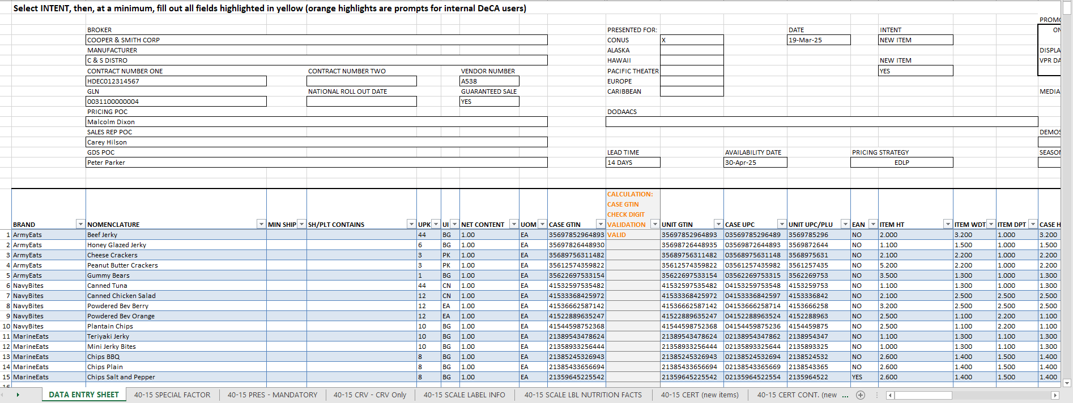
40-15 Worksheet EBS – Example of Vendor completing DATA ENTRY SHEET
Once DATA ENTRY SHEET is completed, Vendor can validate the GTIN by first seeing is “VALID” populated on the DATE ENTRY SHEET. If Vendor has entered the CASE GTIN incorrectly the “VALID” will NOT generate
Please provide Phone # and email address for each
999-864-8978 /Malcolm.Dixon@c&s.com
999-864-8979 /Carey.Hilson@c&s.com
999-864-8979 /Carey.Hilson@c&s.com

Slide 11
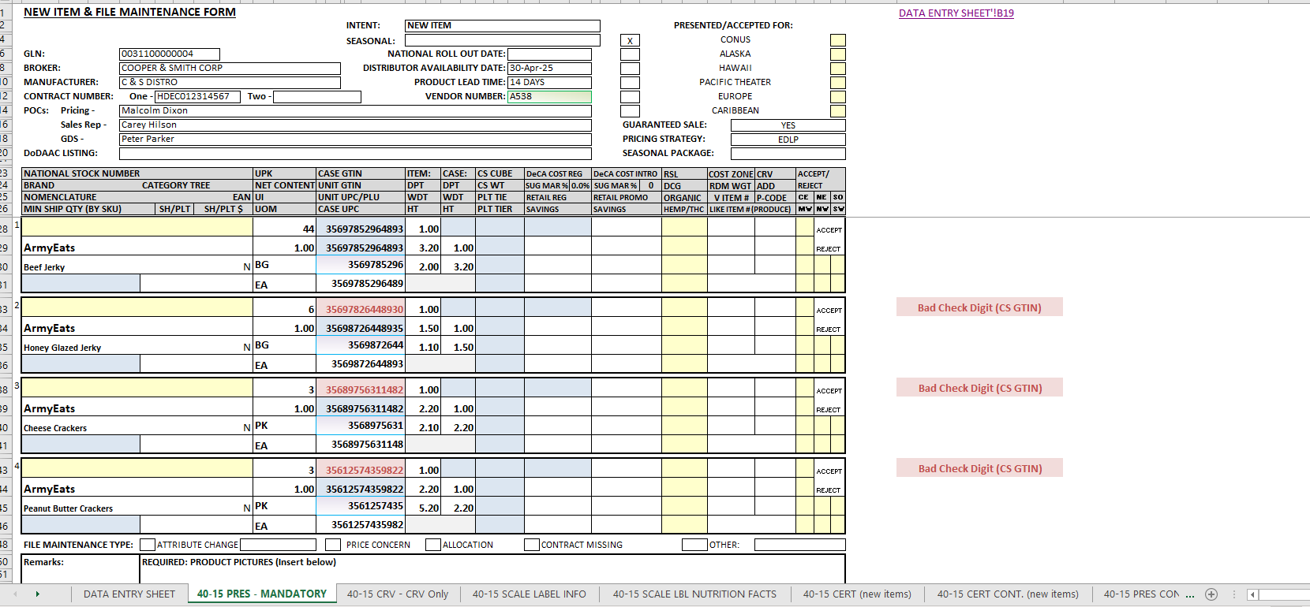
40-15 GTIN VALIDATION - INCORRECT ENTRY
If Vendor enters the CASE GTIN incorrectly; the 40-15 MANDATORY TAB will also notify the vendor with a “BAD CHECK DIGIT(CS GTIN)
40-15 GTIN VALIDATION - CORRECT ENTRY

Slide 12
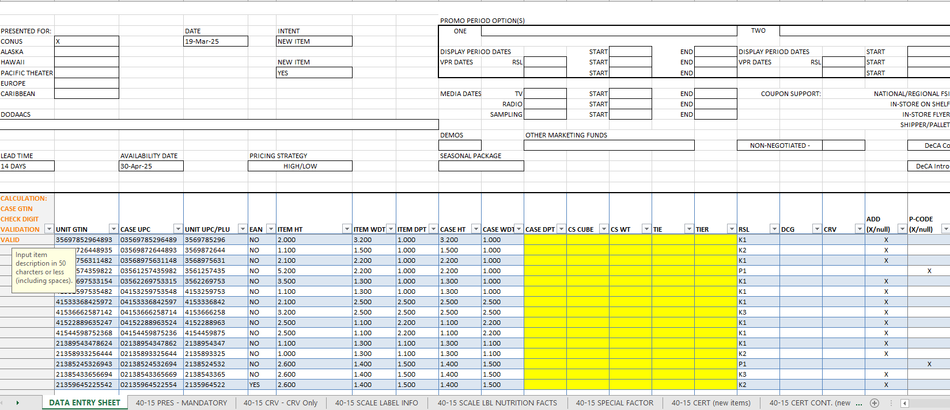
Filling in RSL / Add / P-Code Columns
Enter RSL
Vendor should ensure an “X” is only indicated under the P-code column for “P” RSLs, that vendor intends to Delete! PUT and “X” under ADD when adding an active RSL such as K,R,S, M etc.

Slide 13
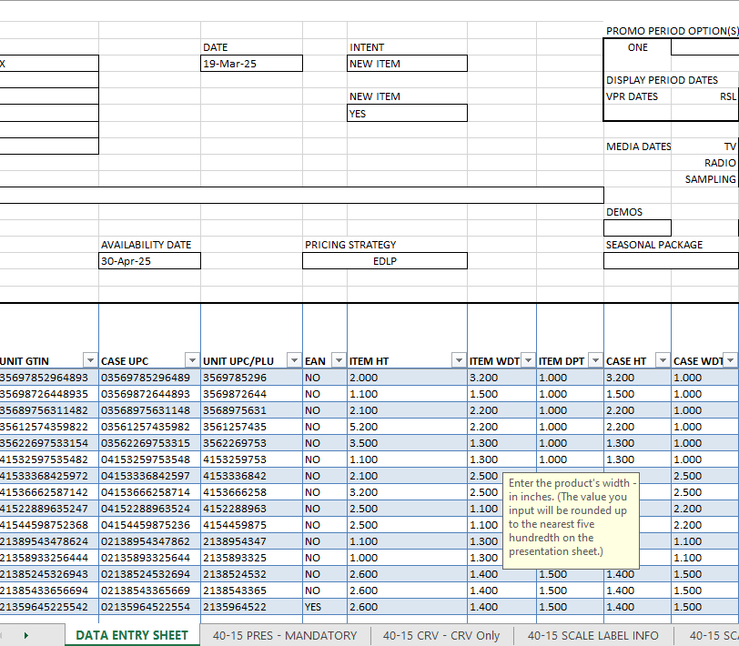
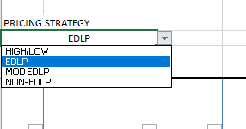
Pricing Strategies ( EDLP & HIGH-LOW)
If the Vendor has filled out the TOP portion of the form correctly they should have selected the CORRECT PRICING STRATEGY. This will be extremely important when it is time to begin entering cost and adjustments.
4 Options indicated below.
Drop-down Options

Slide 14
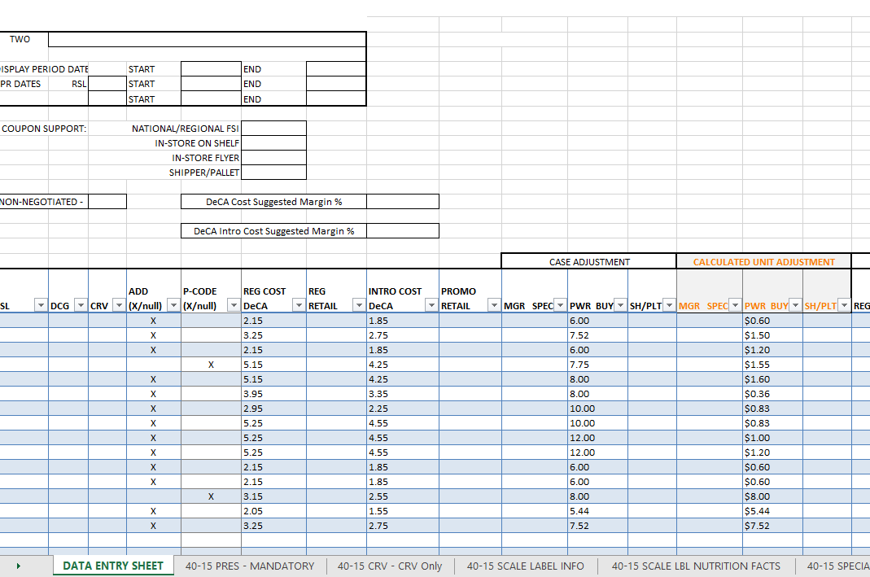
Entering DeCA Costs, Suggested Retails, and Adjustments
VENDOR ENTERS CASE ADJUSTMENT -Once the case adjustment is entered the Calculated Unit Adjustment automatically calculates/populates.
If Vendor notices a discrepancy with the unit adjustment calculation, vendor needs to verify the UPK and Case adjustment has been entered correctly!

Slide 15
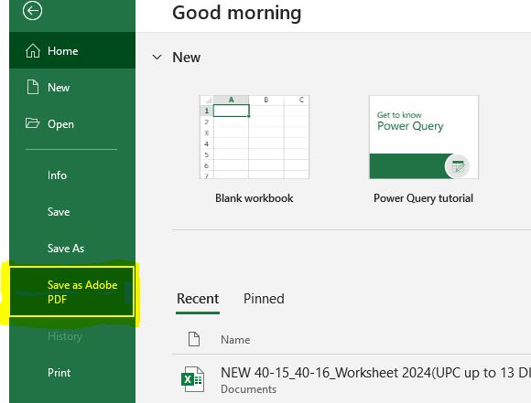
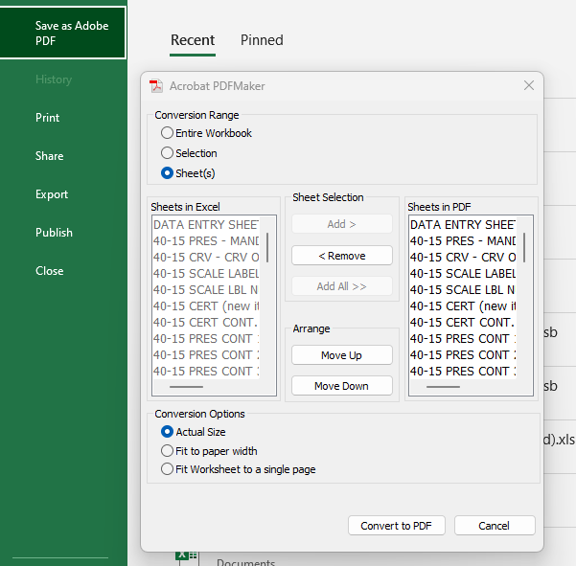
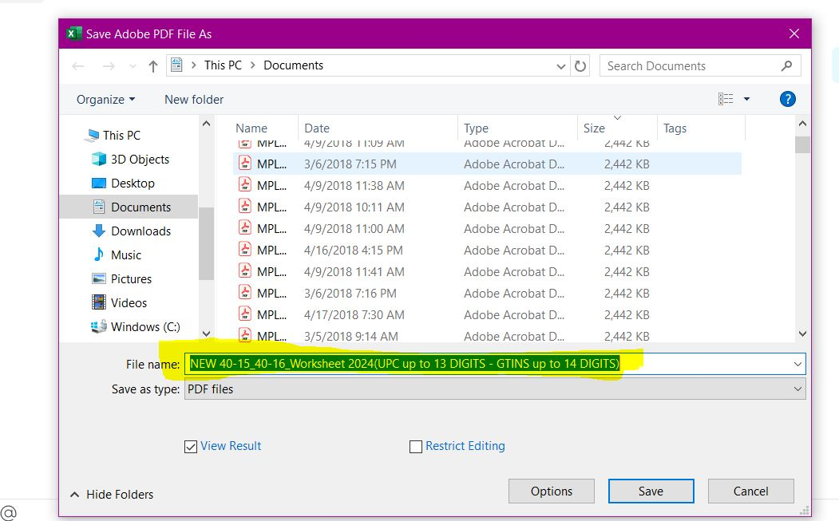
40-15 – Converting to PDF
(Vendors MUST CONVERT the excel tabs to PDFs before sending to DECA for review)
STEP 1:
Select ALL TABS that have data entered by holding the shift key and clicking each with the mouse. Use this method only if vendor knows the EXACT tabs you want to convert to PDF . If vendor wants to convert all tabs then go to STEP 2
STEP 2:
Click FILE in upper left corner – Click SAVE AS ADOBE PDF.
STEP 3:
This menu will populate with all the tabs - click ADD ALL they should move under “Sheets in PDF” - Click Convert to PDF
(Vendor will get an Acrobat message - click YES)
STEP 4:
This window will populate- Name your form by your brand/vendor information – click SAVE
DO NOT SELECT ONE AT A TIME!

Slide 16
Timely Processing Must Haves
  Top portion of DATA ENTRY SHEET
Vendor Number: defines the number established by DeCA contracting. These vendor numbers typically will end in -01 for Conus regions and/or -02 for OCONUS regions. (Example: N003-01, N003-02) If you have the same items for the same vendor number ensure you indicate -01, -02, etc. in the vendor number box. This helps the File Maintenance Team identify which contract belongs to CONUS/OCONUS (ex. A232-01, A232-02)
The vendor # will be the first thing the file maintenance team enters to build our make changes to your item. Very IMPORTANT, form will be rejected without it
Contract Number: defines what year a contract was established, Procurement Instrument Identification Number (PIIN) Indicate if the item should be added to more than 1 contract. Example of a Contract # : HDEC0120G1234 and HDEC0120G2456
Please ensure the contract number is associated with the correct vendor number indicated on the form.
In the event that the “-02” contract is not indicated on the form, it will be assumed there is NOT an existing “-02” contract. The DeCA team will not verify if there is an second contract/vendor # if the vendor does not indicate it.
Failure to follow these guidelines will result in a rejected form

Slide 17
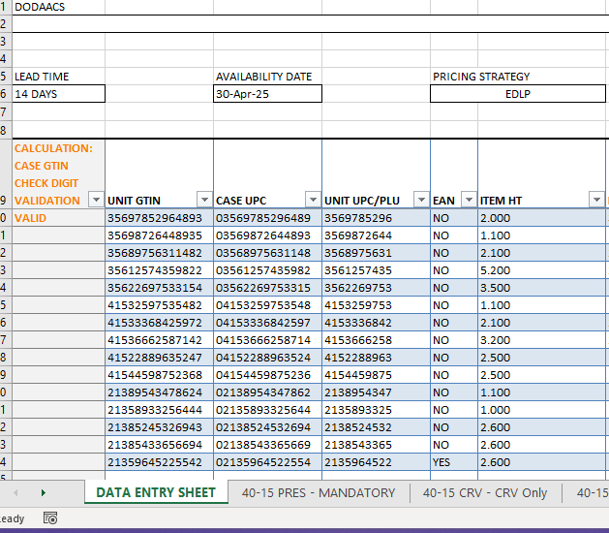
Timely Processing Must Haves
UNIT UPC’s: Should be between 10-13 digits depending on your item barcode. Our database will only allow us to input the first 12 digits, and a check digit will populate automatically for the 13th digit IF your item’s barcode includes all 13 digits. Note: Not all UPC’s will be the full 13 digits. You are required to know the correct UPC information. To assist File Maintenance in adding these items correctly in our database please provide a picture of the barcode in the remarks section ensuring that the numbers are legible to read.
CASE GTINs: Should be 14 digits long. No exceptions! Vendors are required to know the correct GTINs for their products. DECA does not provide these.
EAN: European Article Number: Please select “YES” or “NO” under the EAN column on the DATA ENTRY SHEET to indicate if the item has a UPC or EAN . Indicating this will assist file maintenance team with interpreting how the item will be input into PHQ and unlike UPC’s ; the vendor is expected to provide the check digit for EANs.

Slide 18
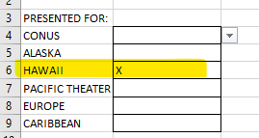
Timely Processing Must Haves
PRESENTED/ ACCEPTED FOR: If ALL areas have the same cost/price check the Conus block only. If Hawaii/Alaska has a different cost/price submit on a separate 40-15/40-16 indicating the cost for those areas. Combine all forms into one PDF document to minimize issues.
**Hawaii only vendors check Hawaii box only**
LINE ITEM UPDATES: When product data updates and changes are required you MUST submit those changes on a 40-15(Data Entry Sheet), no exceptions!
Any 40-15 Corrections requested by File Maintenance to the vendor must be responded to in 24 hrs.
SALES REP SIGNATURE: Sales Representative will digitally sign the 40-15 and/or 40-16 PRES Mandatory tab before sending to DeCA. All information must be verified for accuracy prior to signing and submitting to DeCA to be input.
(Note: this signature can be Digital, Adobe, or hand signed)
Failure to follow these guidelines will result in a rejected form.

Slide 19
Contact Information
POCs for 4015/40-16 Instruction Storyboard
POC for DeCA Form 40-15/4016 Technical Support
Tita Kalua’u
Promotions - Business Management Specialist
Email: Tita.Kalua’u@deca.mil
Office: (804) 734-8000 Ext. 52879
Trevor Cain
Management & Program Analyst
Email: Trevor.Cain@deca.mil
Nickolas Galindo
Promotions - Promotions Coordinator
Email: Nickolas.Galindo@deca.mil
Office: 804-734-8000 Ext. 48223
Lashaunda C. Cooper
Chief, Retail Business Analytics,CPCA,CFM3
Email: lashaunda.cooper@deca.mil
Office: 804-734-8000 Ext 48125
POCs for 40-15 File Maintenance Issues (Item UPC/GTIN level issues)
Irving E. Cockrell Jr.
Lead File Maintenance Assistant
Email: irving.cockrell@deca.mil
Office: 804-734-8000 Ext 48241
Ikeena T. Henderson
Lead File Maintenance Assistant
Email: Ikeena.Henderson@deca.mil
Office:804-734-8000 Ext 48646
Thank you for choosing to partner with your local commissary!

